Slide 1
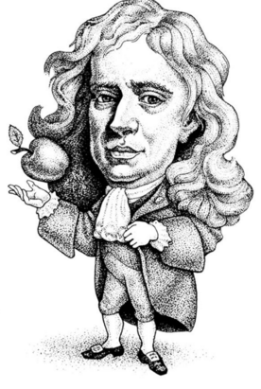
Something Old, Something New(ton)
There’s always
an apple.
Newton’s Laws and the Tension Force

Slide 2
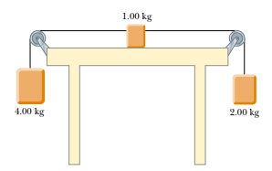
Learning Objective
Utilize Newton’s Laws to solve complex problems including scenarios involving ropes, pulleys and gravity.

Slide 3
Newton’s Laws Big Ideas
Newton’s First (the Law of Inertia) – the net force on objects at rest or in constant velocity motion is zero.
Implications:
If an object isn’t moving, or is moving with constant velocity, the forces acting on it are balanced. That is:
ΣF_{x} = 0 AND ΣF_{y} = 0
If the forces acting on an object ARE balanced, the object is either moving with constant velocity or at rest.
If a net force acts on an object, it will accelerate.

Slide 4
Newton’s Laws Big Ideas
Newton’s Second: The net force acting on an object of mass m will produce an acceleration a:
ΣF = ma
Implications:
If a net force is acting on an object, the object will accelerate.
If an object is accelerating, the forces acting on it are NOT balanced.

Slide 5
Force of Tension
Definition: Tension (often denoted T or F_{T}) is a force that is transmitted by a string, cable, cord, etc., that is pulled tight.
On Free-Body Diagrams, tension forces are always drawn parallel to the strings, cables, or cords, and away from the objects upon which they pull.
F_{T}

Slide 6
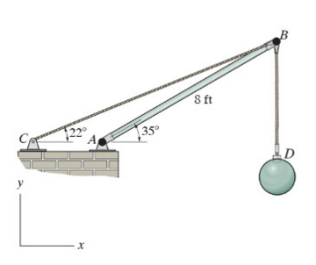
Massless Strings??
It’s just easier this way for now. When our strings or cables are “massless”, the tension in the strands is constant throughout the strand.
If the cable seen below has mass, you can see that the tension in the cable near point B is going to be greater than the cable at point D, because point B is supporting the weight of the wrecking ball and the cable above it.

Slide 7
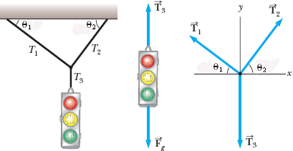
Finally…
Tension is just another type of force you’ll draw and/or see on a free-body diagram.
As always, look at the scenario, draw a good free-body diagram, and solve for any unknowns by applying Newton’s Laws.

