Slide 1
Waves and Sound Review

Slide 2
Which of the following waves requires a material medium through which to travel?
(a) Sound
(b) Television
(c) Radio
(d) X ray
Q1

Slide 3
(a) Sound
Sound is a mechanical wave, transferred through air, or other media, by vibrations passed along through the media. by meaning that it requires a medium through which to travel.
All the other types listed are electromagnetic in nature.
Q1

Slide 4
Describe the difference between transverse and longitudinal waves. Be clear.
Q2

Slide 5
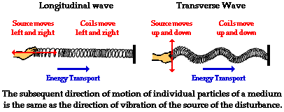
The medium in which a transverse wave travels oscillates perpendicular to the direction of wave travel. The medium in which longitudinal waves travel oscillates parallel to the direction of wave travel.
Q2

Slide 6
(a) What is the wavelength of the following sound wave? (b) If the speed of sound is 340 m/s, what is the frequency of the wave?
12 m
Q3

Slide 7
$$λ=\frac{12 m}{5 waves}=2.4 m$$
$$f=\frac{v}{λ}=\frac{340\frac{m}{s}}{2.4 m}=141.2 Hz$$
12 m
Q3

Slide 8
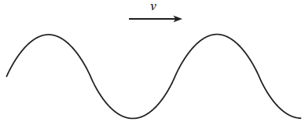
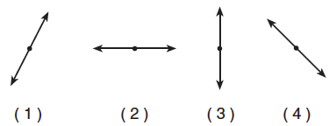
A transverse wave passes through a uniform material medium from left to right, as shown in the diagram below. Which diagram best represents the direction of vibration of the particles of the medium?
Q4

Slide 9
The wave shown is a transverse wave. If the waves move toward the right, the particles of the medium oscillate up and down (perpendicular to the direction of wave travel).
Q4

Slide 10
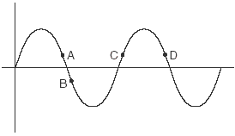
What is the period of a water wave if 4 complete waves pass point A in 10 seconds? What is the wavelength if the waves travel at a speed of 20 m/s?
Q5

Slide 11
$$f=\frac{\# waves}{time}=\frac{4 waves}{10 sec}=0.4 Hz$$
$$λ=\frac{v}{f}=\frac{20\frac{ m}{s}}{0.4\frac{1}{s}}= 50 m$$
Q5

Slide 12
For the periodic wave shown, where 12 waves pass point A in one minute, find:
What is the wavelength of the waves?
What is the amplitude of the wave?
What is the frequency of the wave?
What is the wave speed?
Q6

Slide 13
$λ=\frac{8.0 m}{2.5 waves}=3.2 m$
A = 1.20 m/2= 0.60 m
$v=fλ=\left(0.2 Hz\right)\left(3.2 m\right)=0.64 m/s$
$$f=\frac{\# waves}{time}=\frac{12 waves}{60 sec}=0.2 Hz$$
Q6

Slide 14
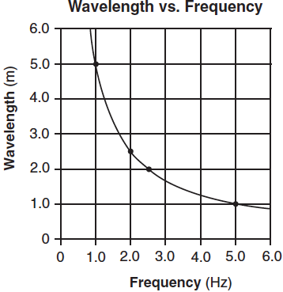
The graph below represents the relationship between wavelength and frequency of waves created by two students shaking the ends of a loose spring.
Calculate (a) the speed of the waves generated in the spring and (b) the period of a wave having a wavelength of 3.0 meters.
Q7

Slide 15
$$v=fλ=\left(5Hz\right)\left(1m\right)=5 \frac{m}{s}$$ $f=\frac{v}{λ}=\frac{5\frac{m}{s}}{3 m}=1.67 Hz$ $$T=\frac{1}{f}=\frac{1}{1.67 Hz}=0.6 sec$$
Q7

Slide 16
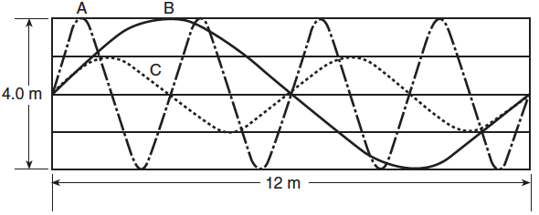
Three waves, A, B, and C, travel 12 meters in 2.0 seconds through the same medium as shown in the diagram below
What is the amplitude of wave C?
What is the speed of wave B?
What is the period of wave A?
Q 8

Slide 17
Ac = 1.0 m
All waves: $v=\frac{12 m}{2.0 s}=6.0 \frac{m}{s}$
$v=\frac{λ}{T} ∴T=\frac{λ}{v}=\frac{3m}{6.0\frac{m}{s}}=0.5 sec$
Q 8

Slide 18
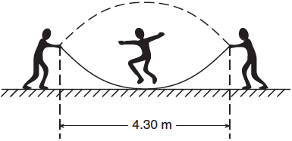
While playing, two children create a standing wave in a rope, as shown in the diagram below. A third child participates by jumping the rope.
What is the wavelength of this standing wave?
Q 9

Slide 19
λ=2L = 2(4.30 m) = 8.60 m
Q 9

Slide 20
The diagram below shows two pulses approaching each other in a uniform medium.
Which diagram best represents the superposition of the two pulses?
(a)
(c)
(d)
(b)
Q 10

Slide 21
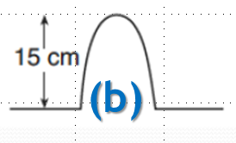
When the two waves occupy the same location, the wave amplitudes add together. This wave behavior is known as constructive interference.
Q 10

Slide 22
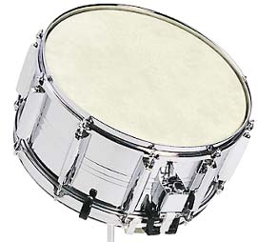
Playing a certain musical note on a trumpet causes the spring on the bottom of a nearby snare drum to vibrate. This phenomenon is called _______________.
resonance
Q 11

Slide 23
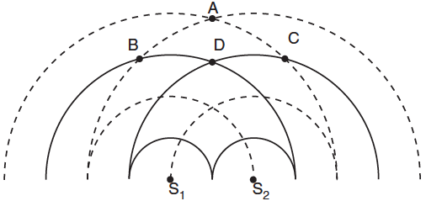
Two speakers, S1 and S2, operating in phase in the same medium produce the circular wave patterns shown in the diagram below.
List the points of constructive interference.
Q 12

Slide 24
Constructive interference occurs when crest meets crest, or trough meets trough.
Q 12

Slide 25
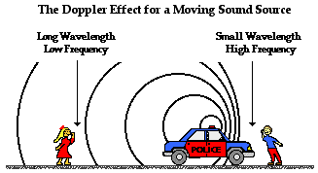
A police siren (f = 1000 Hz) approaches a stationary listener with a speed of 32 m/s. What is the frequency observed by the listener?
Q 13

Slide 26
$$f_{0}=f_{s}\left(\frac{v+v_{o}}{v−v_{s}}\right)=1000 Hz\left(\frac{340 \frac{m}{s}+0\frac{m}{s}}{340\frac{m}{s} −32 \frac{m}{s}}\right)=1100 Hz$$
Q 13

Slide 27
In the diagram below, a stationary source located at point S produces sound having a constant frequency of 512 hertz. Observer A, 50 meters to the left of S, hears a frequency of 512 hertz. Observer B, 100 meters to the right of S, hears a frequency lower 512 Hz.
Which statement best describes the motion of the observers?
(a) A is moving toward point S, and B is stationary.
(b) A is moving away from point S, and B is stationary.
(c) A is stationary and B is moving toward point S.
(d) A is stationary, and B is moving away from point S.
Q 14

Slide 28
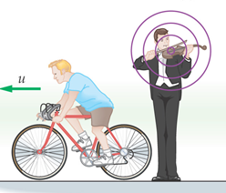
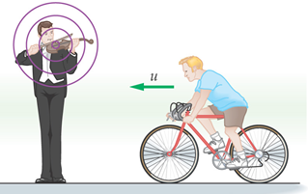
(d) A is stationary, and B is moving away from point S.
An observer moving away from a source will observe a lower frequency, because they are “running away from” the wave fronts.
An observer moving toward a source will observe a higher frequency, because they are running in to the approaching wave fronts.
Q 14

Slide 29
The diagram below represents a standing wave created by a 30 Hz frequency.
12 m
What is the wavelength of the waves that create this?
What is the frequency needed to create the 7th harmonic?
What is the wavelength of the waves that create the 7th harmonic?
Q 15

Slide 30
12 m
(a) $λ=\frac{12 m}{1.5 waves}= 8.0 m$
(b) ${3f}_{1}=f_{3}=30 Hz$
$f_{1}=10 Hz$
$f_{7}=7f_{1}=7\left(10 Hz\right)= 70 Hz$
(c) $λ=\frac{12 m}{3.5 waves}= 3.43 m$
Q 15

Slide 31
The diagram below represents a standing wave.
15 m
What is the frequency that creates this standing wave if the wave speed on the string is 75 m/s?
What are the frequency and wavelength that will produce the second harmonic?
Q 16

Slide 32
15 m
(a) $λ=\frac{15 m}{2.5 waves}=6.0 m$
$f=\frac{v}{λ}=\frac{75 \frac{m}{s}}{6.0 m}=12.5\frac{1}{s}=12.5 Hz$
(b) $f_{5}=5\left(f_{1}\right)=12.5 Hz$
$f_{1}=2.5 Hz$
$f_{2}=2\left(f_{1}\right)=2\left(2.5 Hz\right)=5.0 Hz$
$$λ=\frac{v}{f}= \frac{75\frac{m}{s}}{5.0 \frac{1}{s}}=15 m$$
Q 16

Slide 33
A speaker has a power output of 125 Watts. (a) What is the intensity of sound at a distance of 1.0 meters from the speaker? At a distance of (b) 2.0 meters from the speaker?
Q 17

Slide 34
$$I=\frac{Power}{Area}=\frac{125 W}{{4π(1.0) m}^{2}}= 9.95\frac{W}{m^{2}}$$
$$I=\frac{Power}{Area}=\frac{125 W}{{4π(2.0) m}^{2}}= 2.49\frac{W}{m^{2}}$$
Q 17

Slide 35
A speaker has a power output of 125 Watts. What is the decibel level at a distance of 3.0 meters from the speaker?
Q 18

Slide 36
$$I=\frac{Power}{Area}=\frac{125 W}{{4π(3.0) m}^{2}}=1.11\frac{W}{m^{2}}$$
$$dB=10\log\left(\frac{I}{I_{0}}\right)=10 log\left(\frac{1.11\frac{W}{m^{2}}}{{10}^{−12}\frac{W}{m^{2}}}\right)=110 dB$$
Q 18

Slide 37
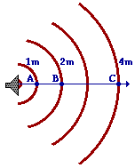
If you double the distance from a source of sound, what happens to the intensity of the sound observed? What if you triple the distance?
Q 19

Slide 38
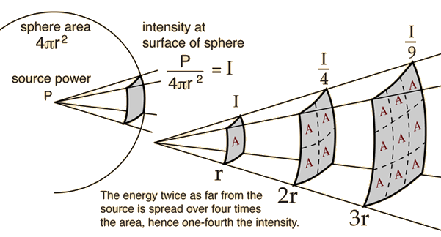
Doubling the distance results in reducing the intensity by a factor of 4 = 2²
Tripling the distance results in reducing the intensity by a factor of 9 = 3²
Q 19

Slide 39
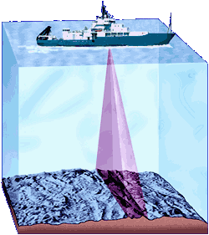
A ship uses sonar to determine the depth of the ocean floor at a location. The ship sends out pulses, and receives the reflected waves 4.2 seconds later. If the speed of sound in seawater is 1497 m/s, what is the depth to the ocean floor below the ship.
Q 20

Slide 40
$$distance=\left(speed\right)\left(time\right)=\left(1497\frac{m}{s}\right)\left(2 sec\right)=3134 m$$ $$depth =\frac{distance traveled}{2}=\frac{3134 m}{2}= 1572 m$$
Q 20

Slide 41
What is the air temperature if the speed of sound is in air is measured to be 352 m/s?
Q 21

Slide 42
$$352\frac{m}{s}=331\frac{m}{s}+0.6\frac{m}{s∙℃}\left(T\right)$$ $$352\frac{m}{s}−331\frac{m}{s}=21\frac{m}{s}=0.6\frac{m}{s∙℃}\left(T\right)$$ $$\frac{21 \frac{m}{s}}{0.6\frac{m}{s∙℃}}=T=35℃$$
Q 21

Slide 43
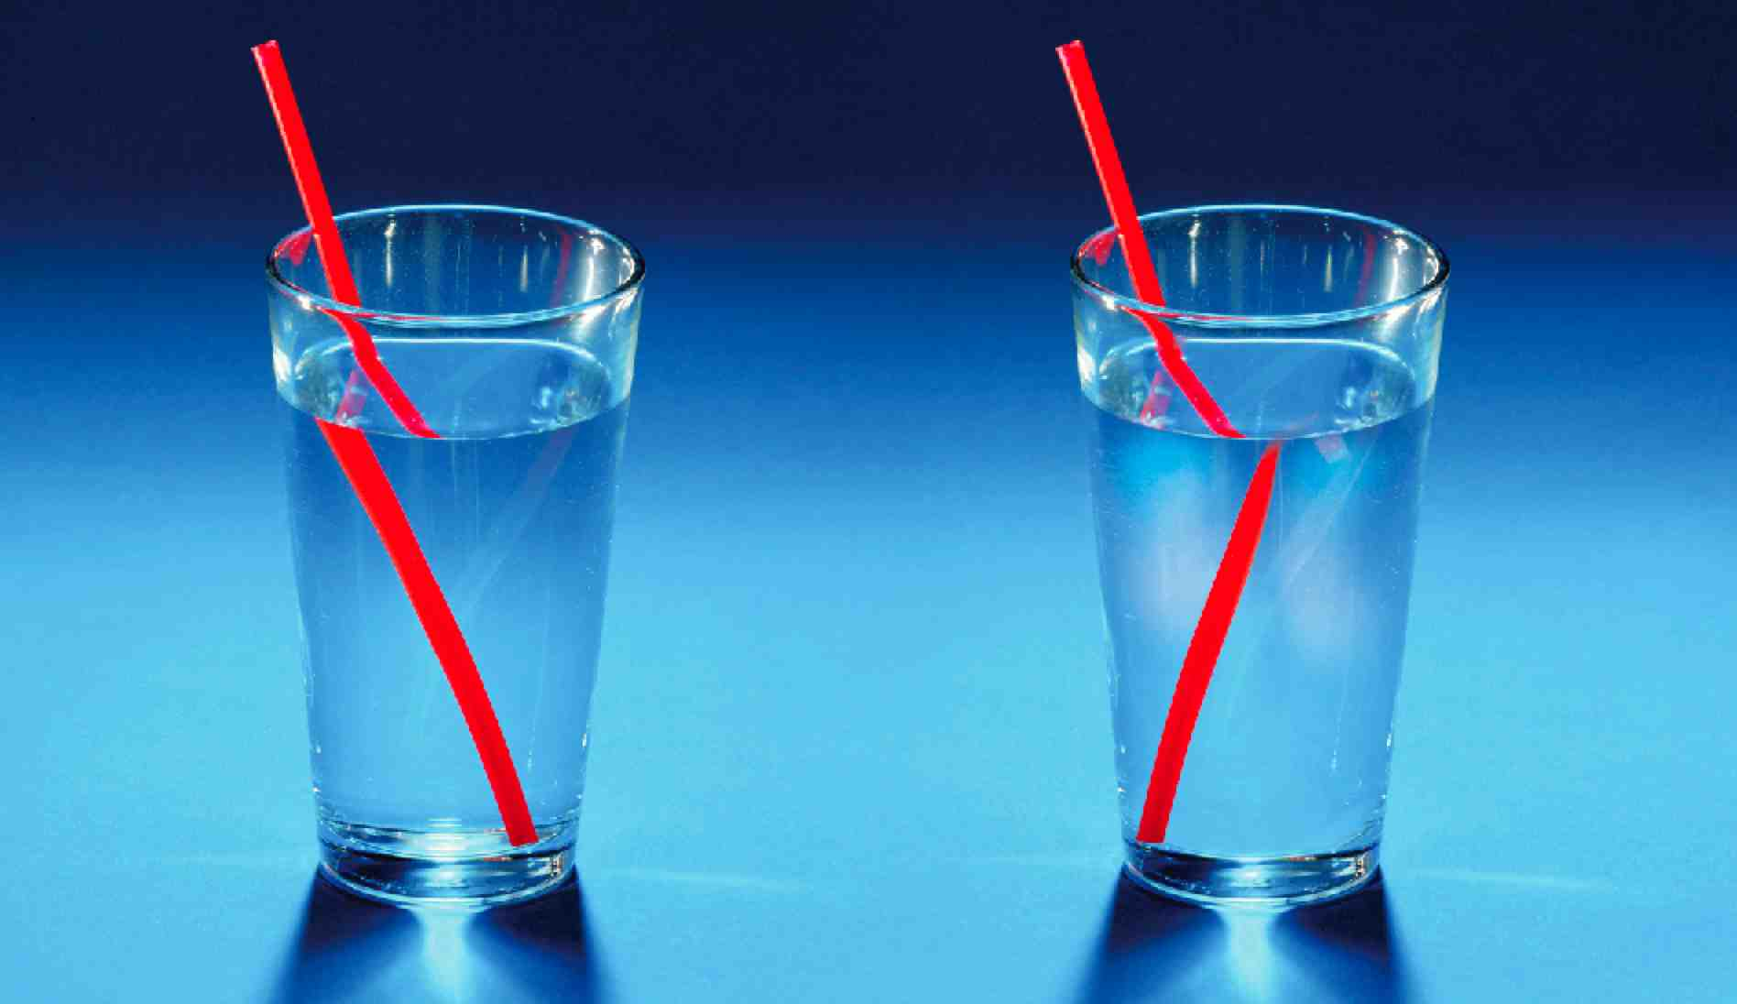
What wave behavior is this image demonstrating?
Refraction
Q 22

Slide 44
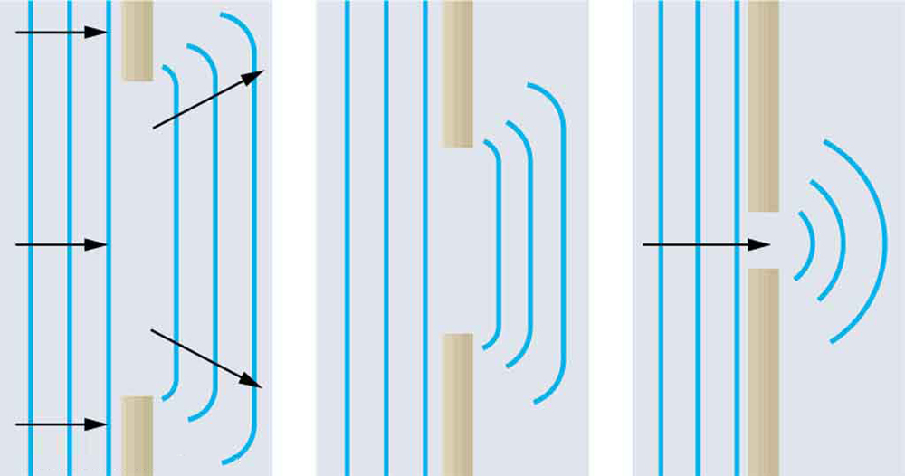
What wave behavior is this image demonstrating?
Diffraction
Q 23

Slide 45
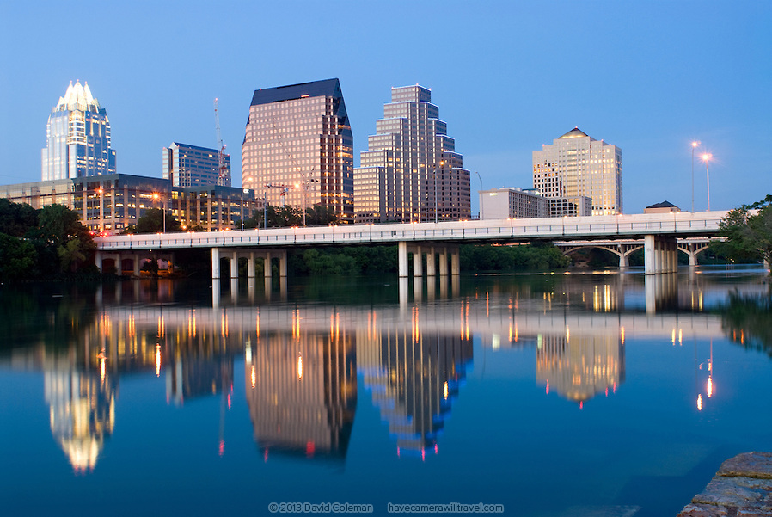
What wave behavior is this image demonstrating?
Reflection
Q 24

